Slide 1

Christmas Lyrics
YAMSEN 2025

Slide 2

All Around the World
All around the world there’s singing
Happy Christmas Day,
Sun or snow, the bells are ringing
All around the world…today.
From north to south,
From toe to mouth,
Music fills our ears.
From east to west
The world is blessed,
Music calms our fears

Slide 3
All Around the World
All around the world there’s singing
Happy Christmas Day,
Sun or snow, the bells are ringing
All around the world…today.
From deserts dry
To mountains high,
Music fills the air.
From fields of flowers
To high-rise towers,
Music’s everywhere!

Slide 4
All Around the World
All around the world there’s singing
Happy Christmas Day,
Sun or snow, the bells are ringing
All around the world…today.
From country lanes
To crowded trains,
Music fills the skies
From camels’ backs
To straw-made shacks,
Music’s the reply.

Slide 5
All Around the World
All around the world there’s singing
Happy Christmas Day,
Sun or snow, the bells are ringing
All around the world…
All around the world there’s singing
Happy Christmas Day,
Sun or snow, the bells are ringing
All around the world…today.
All around the world…today.

Slide 6
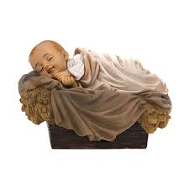
Dormi, Dormi o bel bambin
Dormi, dormi-o bel bambin,
Re divin, re divin,
Fa la nanna-o fantolino
Re divin, re divin,
Fa la nanna-o fantolino
Fa la, fa la, falala la la. Fa la, fa la, falala la.
Fa la, fa la, falala la la. Fa la, fa la, falala la.
Falala lalala, falala lalala, falala lalala, falala la.
Falala lalala, falala lalala, falala lalala, falala la.

Slide 7
Dormi, Dormi o bel bambin
Oh my treasure, do not weep!
Dolce amor, dolce amor.
Close your eyes my son, my dear one.
Dolce amor, dolce amor.
Close your eyes, my son, my dear one.
Fa la, fa la, falala la la. Fa la, fa la, falala la.
Fa la, fa la, falala la la. Fa la, fa la, falala la.
Falala lalala, falala lalala, falala lalala, falala la.
Falala lalala, falala lalala, falala lalala, falala la.

Slide 8
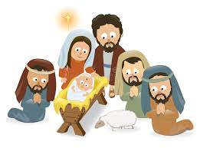
Were you There?
Oh were you there when they laid him in a manger,
Laid him in a manger in Bethlehem?
Were you there when they laid him in a manger,
Laid him in a manger in Bethlehem?
Oh were you there when shepherds came to praise him,
Shepherds came to praise him in Bethlehem?
Were you there when shepherds came to praise him,
Shepherds came to praise him in Bethlehem?

Slide 9
Were you There?
Oh I was there, I was always there
I was standing in the shadows by his side.
‘Twas I who came calling that a
Shooting star was falling and
Three kings upon the camels did
To-wards us ride.
(Three kings upon three camels did
To-wards us ride)

Slide 10
Were you There?
Oh were you there when they laid him in a manger,
Laid him in a manger in Bethlehem?
Were you there when they laid him in a manger,
Laid him in a manger in Bethlehem?
Oh were you there when shepherds came to praise him,
Shepherds came to praise him in Bethlehem?
Were you there when shepherds came to praise him,
Shepherds came to praise him in Bethlehem?

Slide 11
Were you There?
Oh I was there, I was always there
I was standing in the shadows by his side.
‘Twas I who came calling that a
Shooting star was falling and
Three kings upon the camels did
To-wards us ride.
(Three kings upon three camels did
To-wards us ride)

Slide 12
Were you There?
Oh were you there when they laid him in a manger,
Laid him in a manger in Bethlehem?
Were you there when they laid him in a manger,
Laid him in a manger in Bethlehem?
Oh were …
You there?

Slide 13
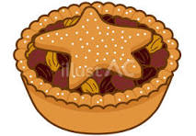
Mince Pies
Pour in the brandy, pour it in
Pour in the brandy, pour it in
Pour in the brandy, pour it in,
Pour. It. In.
Mince pies, mince pies
I’m making mince pies
I’m getting in a mess
But I couldn’t care less
Because I’m having a lovely time
Sprinkle in some raisins,
Sprinkle in some raisins,
Sprinkle in some raisins,
Sprinkle in some raisins,
Sprinkle in some raisins,
Sprinkle in some raisins,
Sprinkle in some,
sprinkle in some raisins
Have a little taste, have a little taste
Have a little taste, have a little taste
Have a little taste, have a little taste
Have a little taste

Slide 14
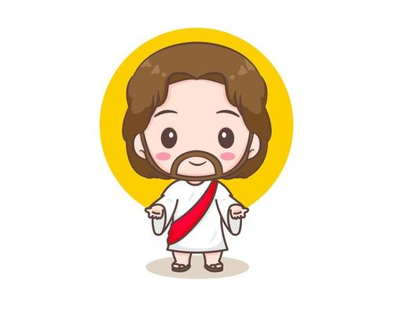
Jesus O What a Wonderful Child
Jesus, Jesus
Oh, what a wonderful child
Jesus, Jesus
So lowly meek and mild
New life, new hope,
new joy he brings
Won't you listen
to the angels sing?
Glory, glory, glory
To the newborn King
He was herald by the angels
Born in a lowly manger
The Virgin Mary was his mother
And Joseph was his earthly father
Three wise men came from afar
They were guided by a shining star
To see king Jesus where he lay
In a manger filled with hay, oh

Slide 15
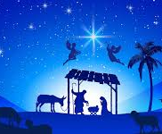
Silent Night
Silent night, holy night
All is calm, all is bright
Round yon virgin, mother and child
Holy infant so tender and mild
Sleep in heavenly peace
Sleep in heavenly peace

Slide 16
Silent Night
Silent night, holy night
Shepherds quake at the sight
Glories stream from heaven afar
Heav’nly hosts sing Alleluia
Christ the Saviour is born
Christ the Saviour is born

Slide 17
Silent Night
Silent night, holy night
Son of God, love’s pure light
Radiant beams from thy holy face
With the dawn of redeeming grace
Jesus, Lord, at thy birth
Jesus, Lord, at thy birth

Slide 18
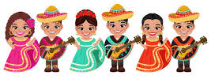
Feliz Navidad
Feliz Navidad Feliz Navidad Feliz Navidad, prospero año y Felicidad Feliz Navidad Feliz Navidad Feliz Navidad, prospero año y Felicidad | I wanna wish you a Merry Christmas, I wanna wish you a Merry Christmas, I wanna wish you a Merry Christmas, From the bottom of my heart. I wanna wish you a Merry Christmas, I wanna wish you a Merry Christmas, I wanna wish you a Merry Christmas, From the bottom of my heart.

Slide 19

Go Tell it on the Mountain
While shepherds kept their watching O'er silent flocks by night, Behold thru-out the heavens There shone a holy light. | Go, tell it on the mountain, Over the hills and everywhere. Go, tell it on the mountain That Jesus Christ is born.

Slide 20
Go Tell it on the Mountain
The shepherds feared and trembled When lo! above the earth Rang out the angel chorus That hailed our Savior's birth. | Go, tell it on the mountain, Over the hills and everywhere. Go, tell it on the mountain That Jesus Christ is born.

Slide 21
Go Tell it on the Mountain
Down in a lowly manger The humble Christ was born, And God sent us salvation That blessed Christmas morn. | Go, tell it on the mountain, Over the hills and everywhere. Go, tell it on the mountain That Jesus Christ is born.

Slide 22
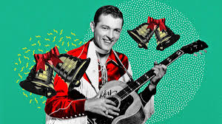
Jingle Bell Rock
Jingle bell, jingle bell, jingle bell rock
Jingle bells swing and jingle bells ring
Snowin' and blowin' up bushels of fun
Now the jingle hop has begun.
Jingle bell, jingle bell, jingle bell rock
Jingle bells chime in jingle bell time
Dancin' and prancin' in Jingle Bell Square
In the frosty air.

Slide 23
Jingle Bell Rock
What a bright time, it's the right time
To rock the night away
Jingle bell time is a swell time
To go glidin' in a one-horse sleigh
Giddy-up jingle horse, pick up your feet
Jingle around the clock
Mix and a-mingle in the jinglin' feet
That's the jingle bell rock

Slide 24
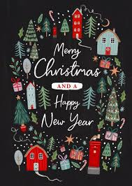
We Wish you a Merry Christmas
We wish you a merry Christmas,
We wish you a merry Christmas,
We wish you a merry Christmas,
And a happy New Year.
Glad tidings we bring
To you and your kin.
We wish you a merry Christmas,
And a happy New Year.

Slide 25
We Wish you a Merry Christmas
Now bring us some figgy pudding,
Now bring us some figgy pudding,
Now bring us some figgy pudding,
And bring it out here.
Glad tidings we bring
To you and your kin.
We wish you a merry Christmas,
And a happy New Year.

Slide 26
We Wish you a Merry Christmas
We won’t go until we get some,
We won’t go until we get some,
We won’t go until we get some,
So bring some out here.
Glad tidings we bring
To you and your kin.
We wish you a merry Christmas,
And a happy New Year.

Slide 27
We Wish you a Merry Christmas
For we all love figgy pudding,
We all love figgy pudding,
We all love figgy pudding,
So bring some out here.
Glad tidings we bring
To you and your kin.
We wish you a merry Christmas,
And a happy New Year.

Slide 28
We Wish you a Merry Christmas
We wish you a merry Christmas,
We wish you a merry Christmas,
We wish you a merry Christmas,
And a happy New Year.
Glad tidings we bring
To you and your kin.
We wish you a merry Christmas,
And a happy New Year.

